Slide 1
Data visualization in R
Workshop #3 in the series
Calvin J. Munson

Slide 2
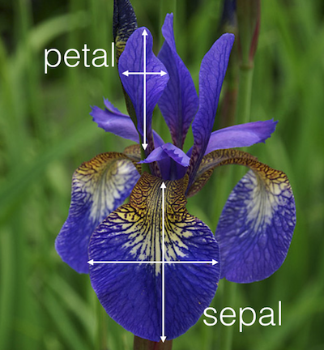
Petal: Colored, modified part which attract pollinators
Sepal: Outer leaf of the flower which protects the reproductive parts
Ronald Fischer,
Edgar Anderson
Collected in 1935

Slide 3
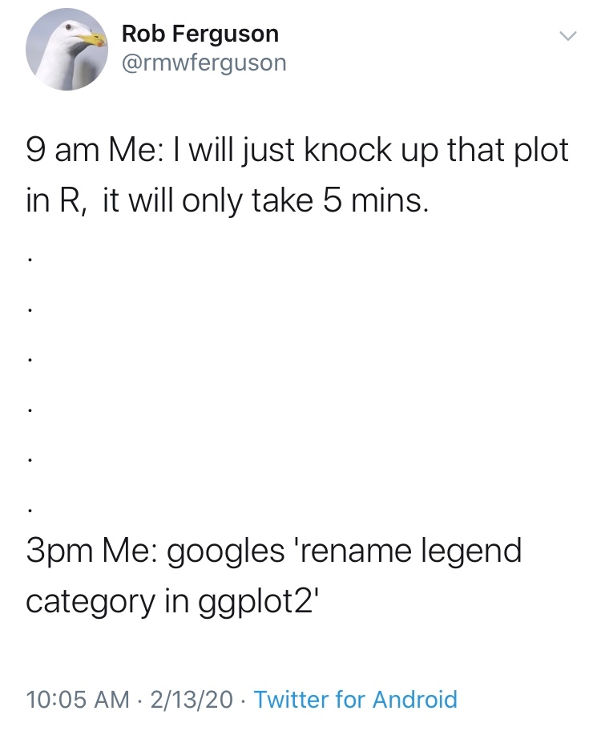

Slide 4
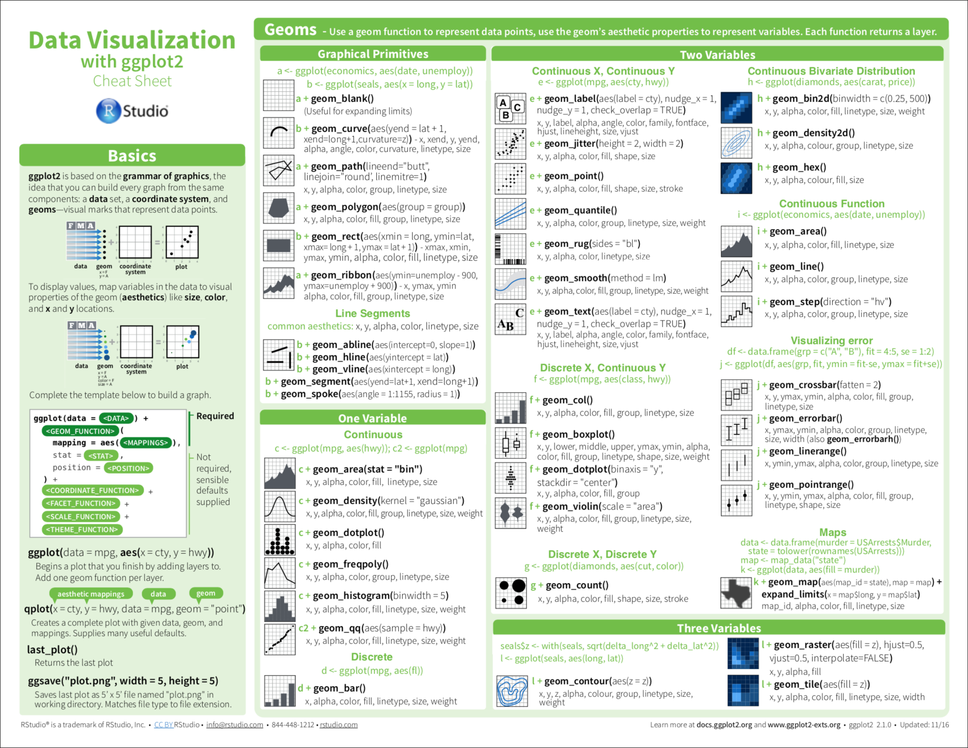

Slide 5
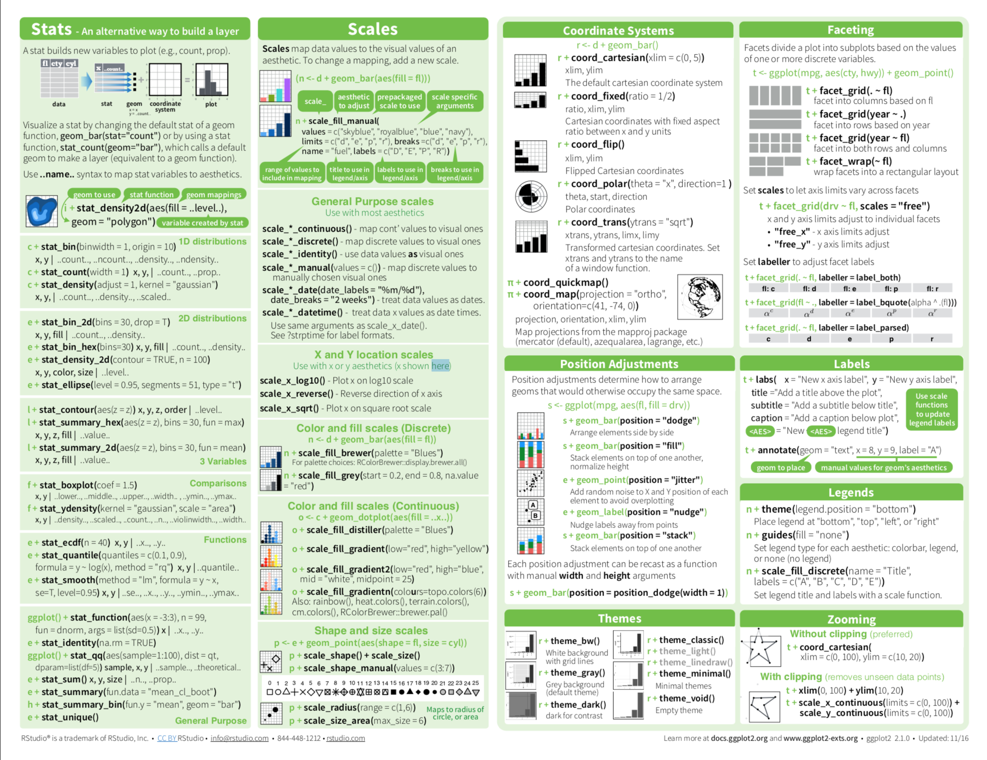

Slide 6
Boxplot annotation
“Maximum”
Interquartile Range
Median
“Minimum”

